Slide 1

Python For Loops!

Slide 2
Definition:
A for loop in Python is used to repeatedly execute a block of code for as long as it can iterate over a certain datatype.
And when the condition becomes false, the line immediately after the loop in the program is executed.

Slide 3
So, what does iterate mean?

Slide 4
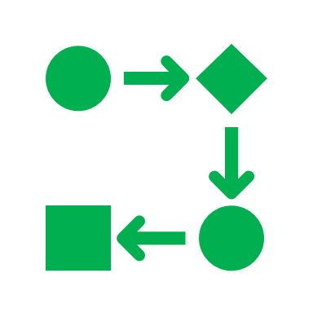
Iteration means taking each item of something, one after another.

Slide 5
When we can iterate over something, we call that thing “iterable”. So, in the next two slides we will iterate over a string.

Slide 6
When we iterate over a string, we iterate over every character (i.e., letters, numbers, punctuation, emojis, spaces) of that string.

Slide 7

For example, the string “hello”
How would you take each item of this?
You would take each character in the string “hello”.
You would iterate 5 times.

Slide 8
Remember, when we iterate over a string, we iterate over every character of that string.

Slide 9
So, what would we get if we iterate over the string “walk now”?

Slide 10
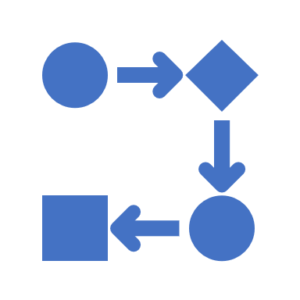
Right, you would take each character in the string “walk now”.
We will iterate 8 times!
(spaces are counted as characters)

Slide 11
For Loop Syntax:
for **iterable** in **iterable_item**:
**block of code to execute**

Slide 12
So, every for loop begins with for, then a name for each item we are iterating over (this can be anything), the word in in the middle, the item to iterate over and a colon at the end.

Slide 13
Example:
my_string = “hello”
for character in my_string:
print(“who?")

Slide 14
So, what will this code do?

Slide 15
Right, it will print out “who" five times!
(Good Job)

Slide 16
There are other iterable datatypes:
Dictionaries:
Lists:
greeting = [“hello”, “hi”]
for item in greeting:
print("hello")
We aren’t there yet! Do some research on your own.

Slide 17
When we iterate over a list, we iterate over each item in that list.

Slide 18
When we iterate over a list, we iterate over each item in that list.

Slide 19
Example:
shopping_list = [“bread”, “milk”, “cheese”, “water”]
for item in shopping_list:
print(“item")

Slide 20
So, what will this code do?

Slide 21
Right, it will print out “item" four times!
(Good Job)

